Slide 1
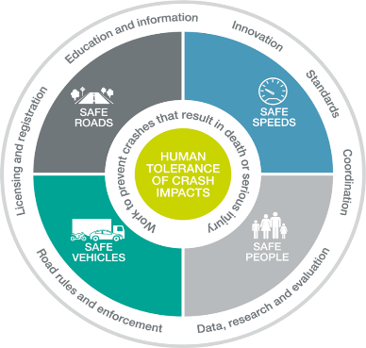
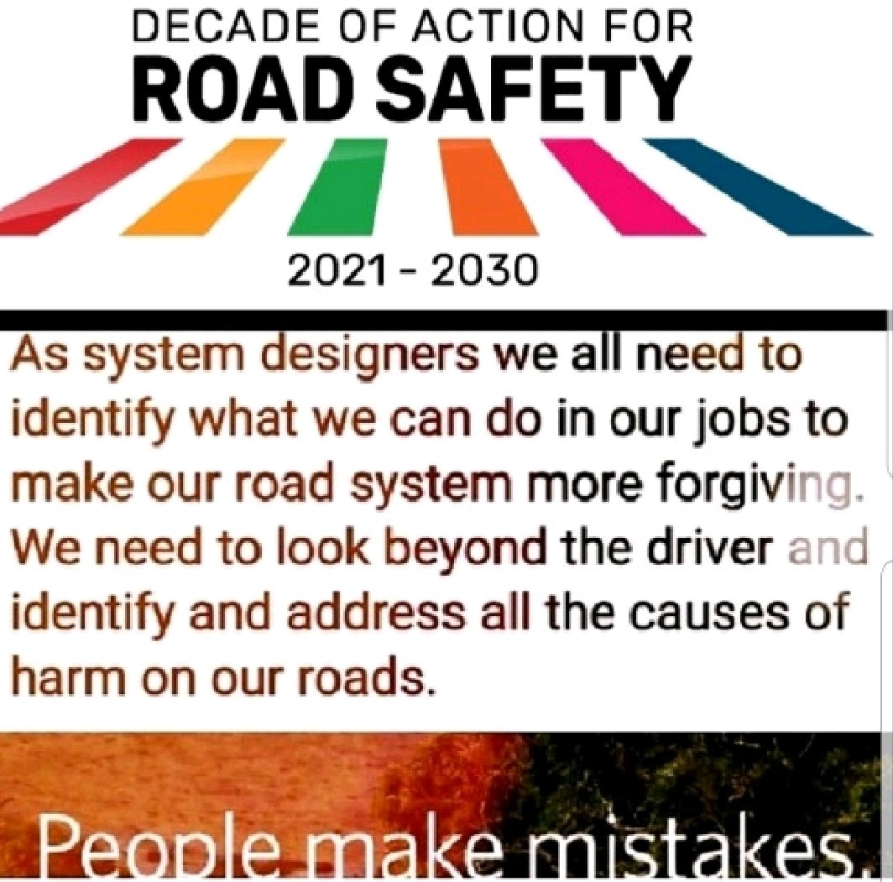
Road Crash Data and Safe System Interventions, Including Road Safety Awareness
Kailash Chandra Tiwari
International Road Safety Management
and Engineering Specialist, Australia
Email: Tiwarikailashji@gmail.com
July 2023

Slide 2
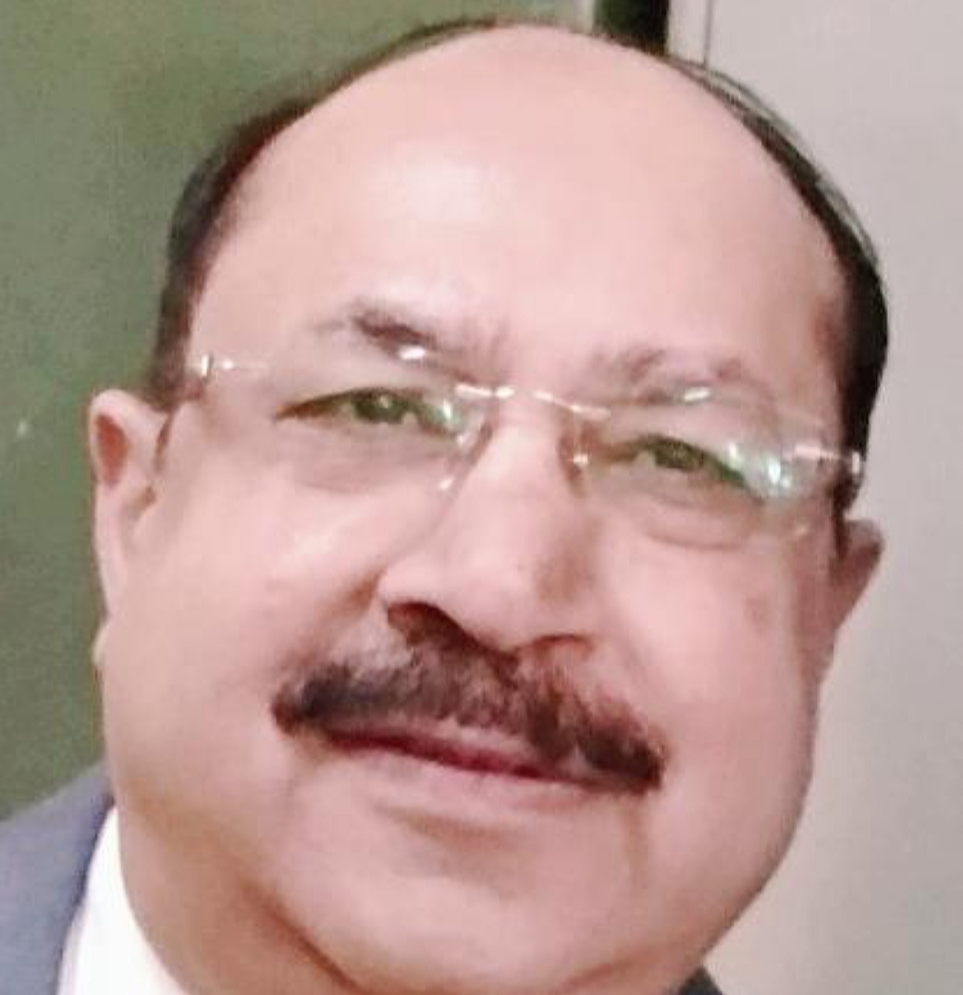
KAILASH CHANDRA TIWARI
Kailash is an Australian Citizen and has a BE plus two master’s degrees (Civil - Traffic and Transportation) from India and Canada. He had researched for PhD at Uni. of NSW, Sydney, Australia.
He has taught to BE / ME / TAFE students in Canada, Australia, and India, and has worked for 45 years in 15 countries.
He has trained over 12,000 professionals on road safety planning, design, management, audit, engineering, education, enforcement, strategies and action plans!
Kailash has worked on over 100 Assignments.

Slide 3
Road Crash Fatalities
Globally, untimely fatalities of road crashes in the last decade had reached 14 million and 50 million injuries! Road crashes had been the leading killer of people aged 5-29 years, as per the #WHO. (18.2 per 100,000 population).
India: Reported road-crashes related lives-lost (fatalities) had been record highest 1,55,622 in 2021, #NCRB India.
Alarming that the fatalities of Pedestrians had been around 19%!

Slide 4
Are we willing to accept millions of untimely fatalities, ten times injuries (ongoing pandemic) and traumas on our roads annually as the norm?
Additional 30% burden on health, law and order sectors, emergency services….. too.
Missed and neglected “duties of care”, so far.

Slide 5
Good road crash data are necessary to get an accurate picture of road safety problems.
Good data can tell the right story and can convince the concerned stakeholders, authorities and users.
Evidence (good and accurate road crash data) based actions on highly effective interventions (as Vaccines and Boosters) are required urgently!

Slide 6
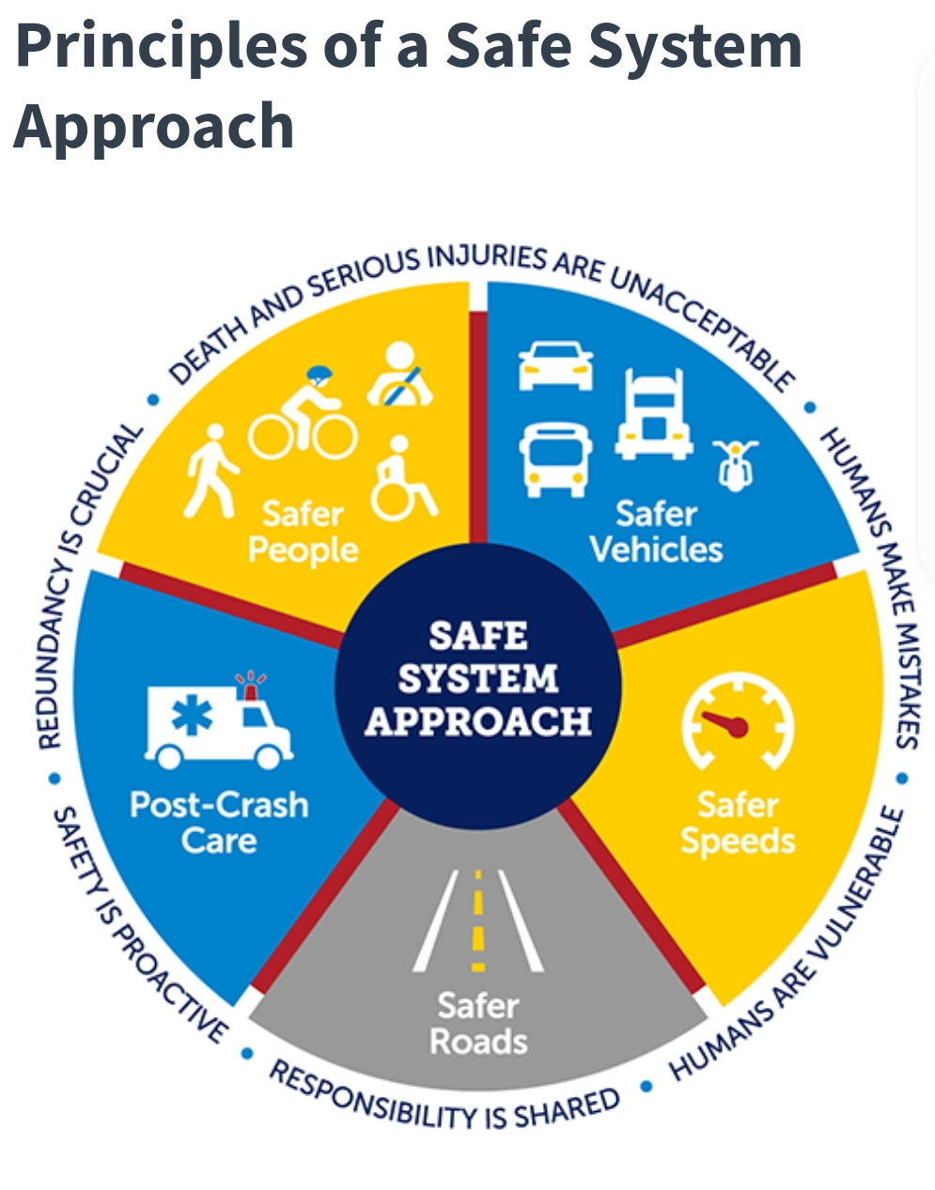

Slide 7

THE SECOND DECADE OF ACTION AND TARGETS
The UN General Assembly Resolution 74/299 declared a Second Decade of Action for Road Safety (2021–2030), with the targets to reduce road traffic deaths & injuries!

Slide 8


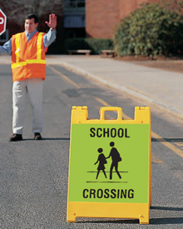

THANK YOU!
Be Visible Be Safe!
The loss and suffering associated with road traffic deaths and injuries are preventable!!

