Slide 1


CAV Technologies to Enhance Road Safety
SWAT Alliance Webinar: Road Safety Awareness
Barrie Kirk, P.Eng., Executive Director, CAVCOE
July 26, 2023

Slide 2

CAVCOE
Consultants: advise corporations, governments on preparing for the era of Connected and Automated Vehicles (CAVs)
Canadian clients: Carleton University, City of London, City of Toronto, Cox & Palmer, Desjardins, DOT Technology, GISA, The Co-operators, Thompson MB, Transport Canada, Urban Systems, Via Rail, Zamboni, etc.
US clients: ADESA, AED, AEMP, Ohio State University, etc.
Overseas clients: HIDO (Japan), Transdev (France), etc.
Speakers’ bureau

Slide 3
CAV Deployment Schedule
 | 2020s | 2030s
Passenger CAVs | Advanced Driver Assistance Systems (ADAS) Limited deployment of geo-fenced automated passenger cars | Large-scale deployment of fully-automated passenger vehicles
Freight CAVs | Warehouses, airports, sea-ports, mining, long-haul, middle-distance, last-mile Strong momentum, especially in controlled environments | Many more robots for wide variety of use-cases
Service CAVs | Grass cutting, sidewalk inspections, automated farming Growing market | Many more robots for wide variety of use-cases

Slide 4
Safety Realities
CAVs will follow the rules
No distractions
360-degree view from multiple sensors
Reaction time 0.1 second vs seconds for humans

Slide 5
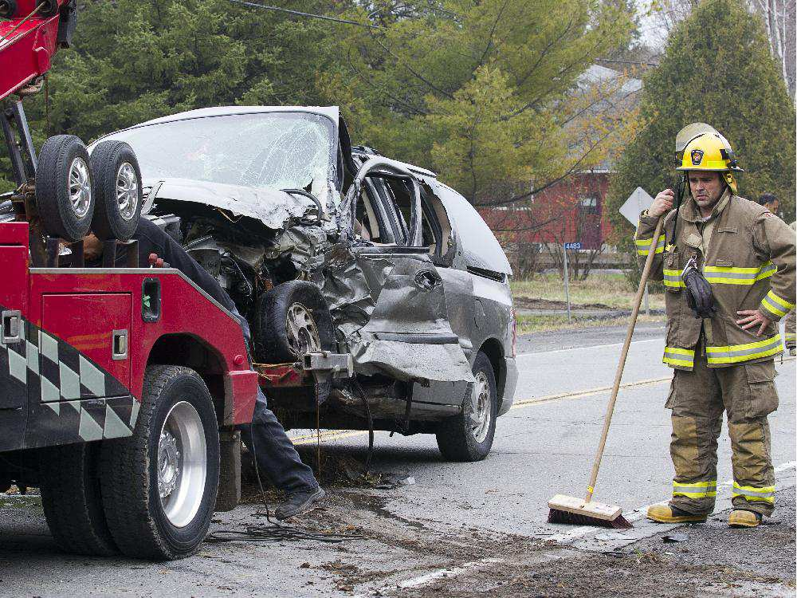
Fewer Collisions
CAVs have the potential to be much safer than human drivers
93% of collisions involve driver error
Hopefully, we can reduce collisions to 20% of current rate
Ottawa Citizen

Slide 6




Great goals but unachievable !!!
All hardware, software fails occasionally
7% of collisions have nothing to do with the driver
  Will happen whether a human or computer is driving
There will be collisions, fatalities, injuries - but far fewer

Slide 7
Issues
The public expects:
  Human drivers will continue to make mistakes
  CAV technology will be perfect
  Important for all stakeholders to help manage the public’s expectations
Laws, best practices must differentiate between driver-assist and full CAVs
Interim period with human drivers and CAVs will be especially dangerous

Slide 8
Other Issues
Who is responsible if there is an accident / injury / death ?
How do police manage incidents involving CAVs?
  What data should a CAV give to police?
  How does a CAV recognize it is being pulled over?

Slide 9
Fast forward to 10+ years
If data confirms that computers are safer drivers:
  Should we ban human drivers ???

Slide 10

Follow-up
Barrie Kirk
  bkirk@cavcoe.com
  +1 613-271-1657
CAV Update
  Free monthly newsletter
  cavupdate.subscribe@
  cavcoe.com
Questions?

